Slide 1
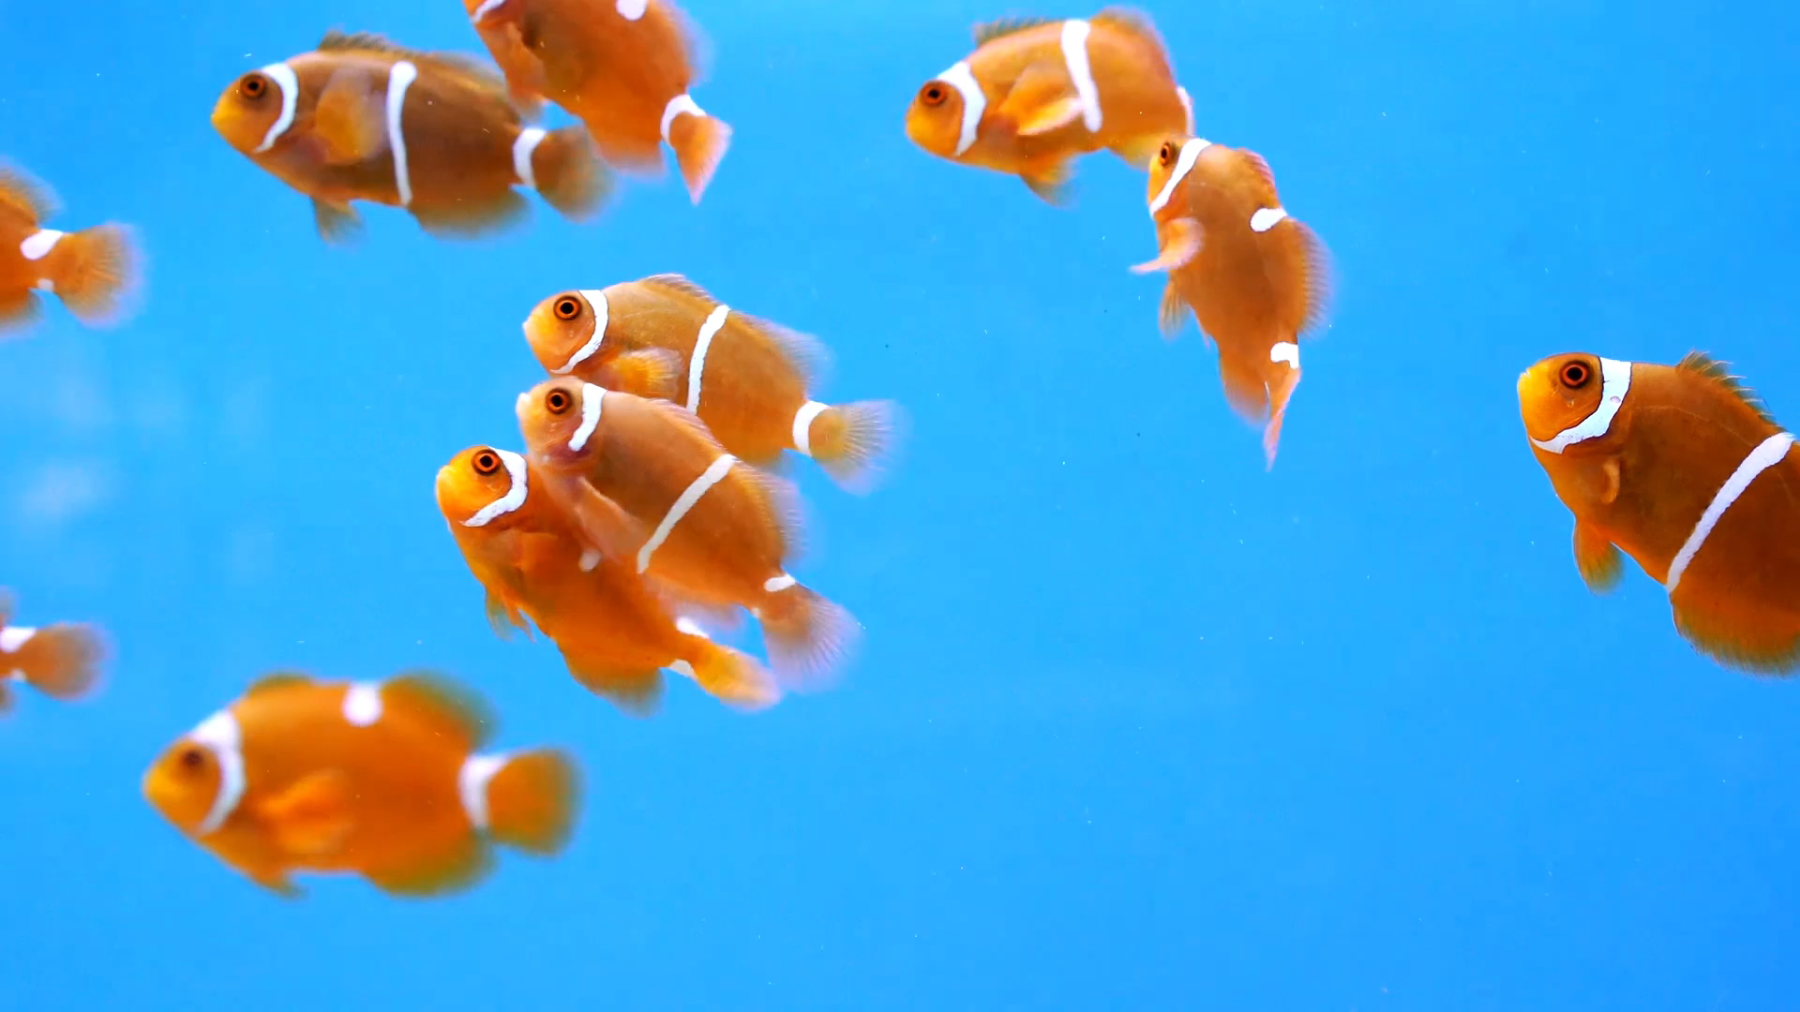
🎣 Fish Image Classification using CNN and Transfer Learning
A Deep Learning approach to identify fish species from images
Details:
By: Kanimozhi D.
Tools: TensorFlow, Keras, Streamlit, Visual Studio

Slide 2

Project Overview
Goal: To build and deploy a Deep learning model that classifies fish images into multiple species.
Key Components:
CNN model built from scratch
Pretrained model (MobileNet)
Streamlit web app for deployment

Slide 3
Motivation
Why Fish Classification?
Supports fishery research and monitoring
Reduces manual identification effort
Helps in seafood quality control and species tracking

Slide 4
Transfer Learning (MobileNet)
Approach:
Used pretrained MobileNet (ImageNet weights)
Fine-tuned top layers with our dataset
Added dense classification head
Result:
Training Accuracy: 99%
Validation Accuracy: 98%
Much faster convergence and better generalization

Slide 5
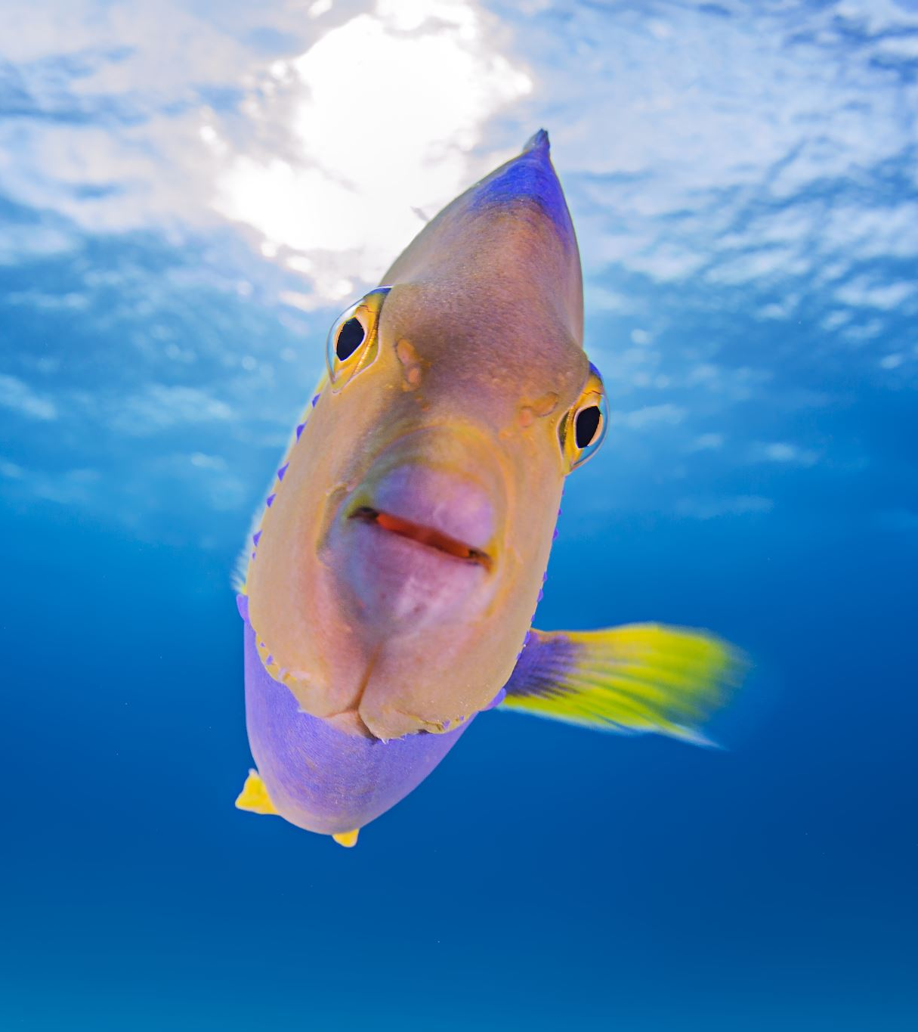
Dataset
Dataset Description:
Collected fish images belonging to 11 categories
Each class folder contains multiple fish images
Examples:
🐟 Sea bass
🦐 Shrimp
🐠 Trout
🐡 Red mullet
STRUCTURE:
Dataset/
|---train/
|---val/
|---test/

Slide 6

Performance Evaluation
Metrics Used:
Precision
Recall
F1-Score
Confusion Matrix
Visualization: 📊 Accuracy/Loss curves 📉 Confusion matrix (low diagonal in scratch model, strong diagonal in pretrained)

Slide 7
Streamlit App Deployment
Features:
Upload any fish image (.jpg)
Model predicts species with confidence level
Displays top predictions
Commands:
streamlit run app.py
Tech Used: TensorFlow + Streamlit +cv2+NumPy

Slide 8
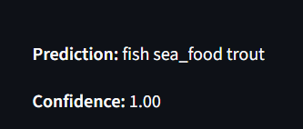
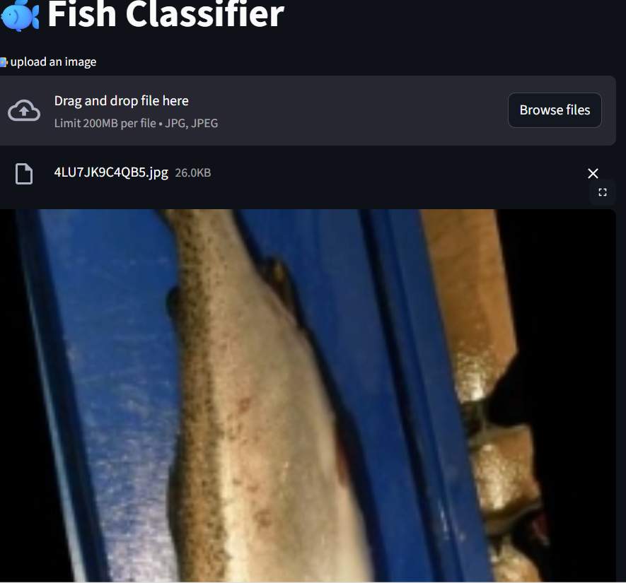
Example App Interface

Slide 9
Conclusion: CNN from scratch performed not well Transfer Learning achieved high accuracy Streamlit app makes model interactive and user-friendly

Slide 10
Thank You
Developed by: Kanimozhi D.
Tools Used: TensorFlow | Keras | Streamlit | VS code
🐟 "Deep Learning beneath the surface — identifying fish smarter!"

